Slide 1
Cryo-EM 3D-processing Strategy Summary
Hsin-Hung, Lin
Wei-Hau, Chang
2017.04.26

Slide 2
Outline
1.Motion Correction
Movies Micrographs to Micrograph
2. CTF Calibration
what is CTF
Conventional EM vs. Phase Plate
3. Particle Picking
4. Several Rounds 2D classification
kick out garbage
kick out bad particle
5. Ab-initial model
cryoSPARC vs. Prime
6. 3D Classification
Highly Convergence
Non Convergence
Heterogeneous Structure
7. Post-processing & FSC

Slide 3
Motion Correction

Slide 4
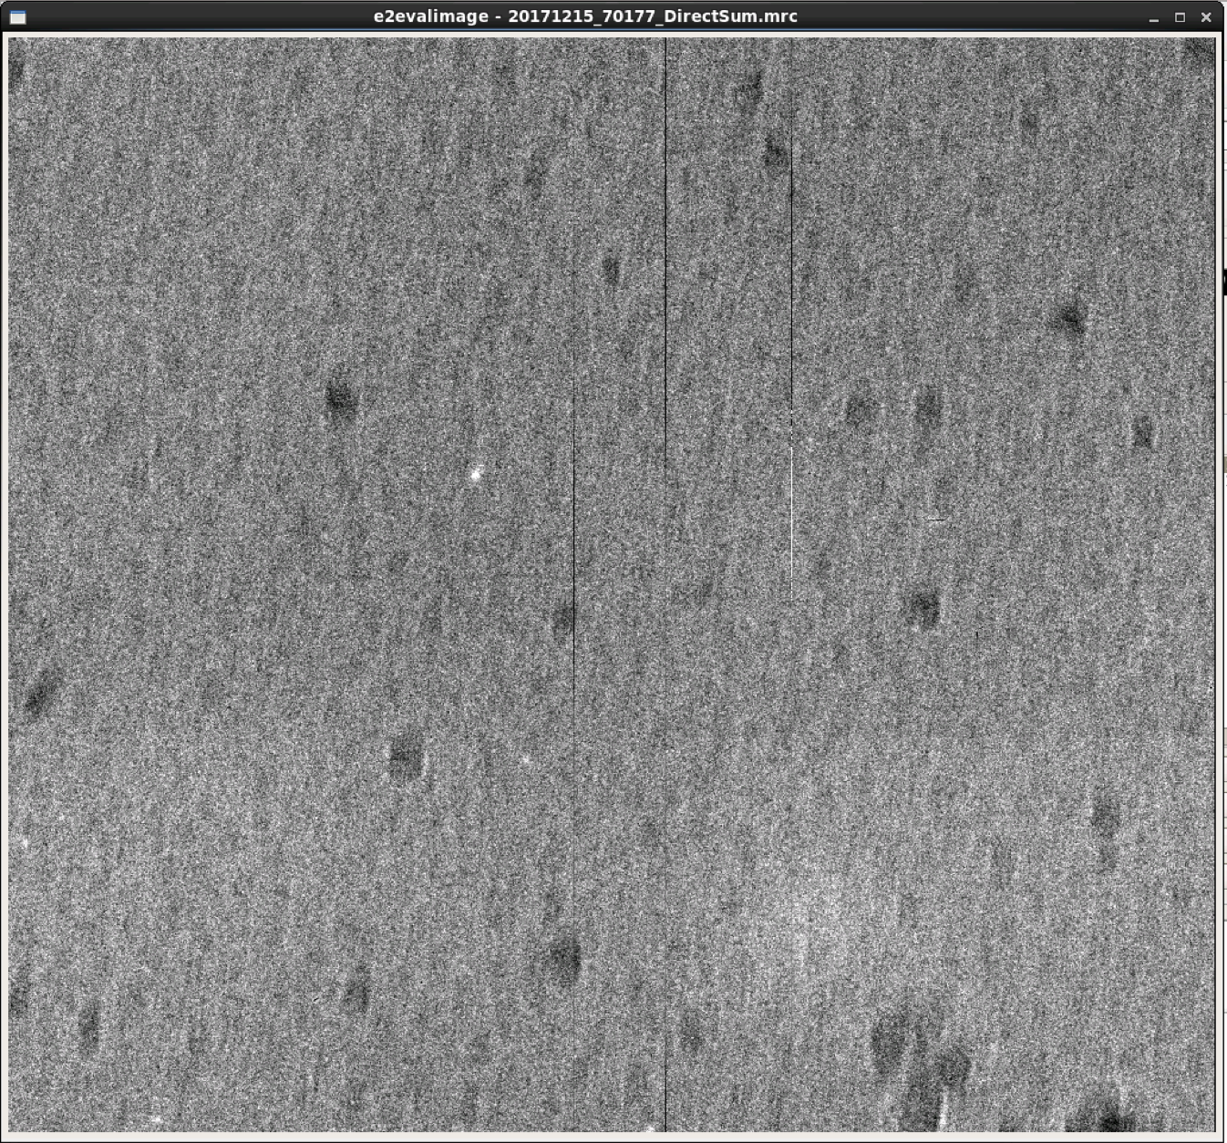
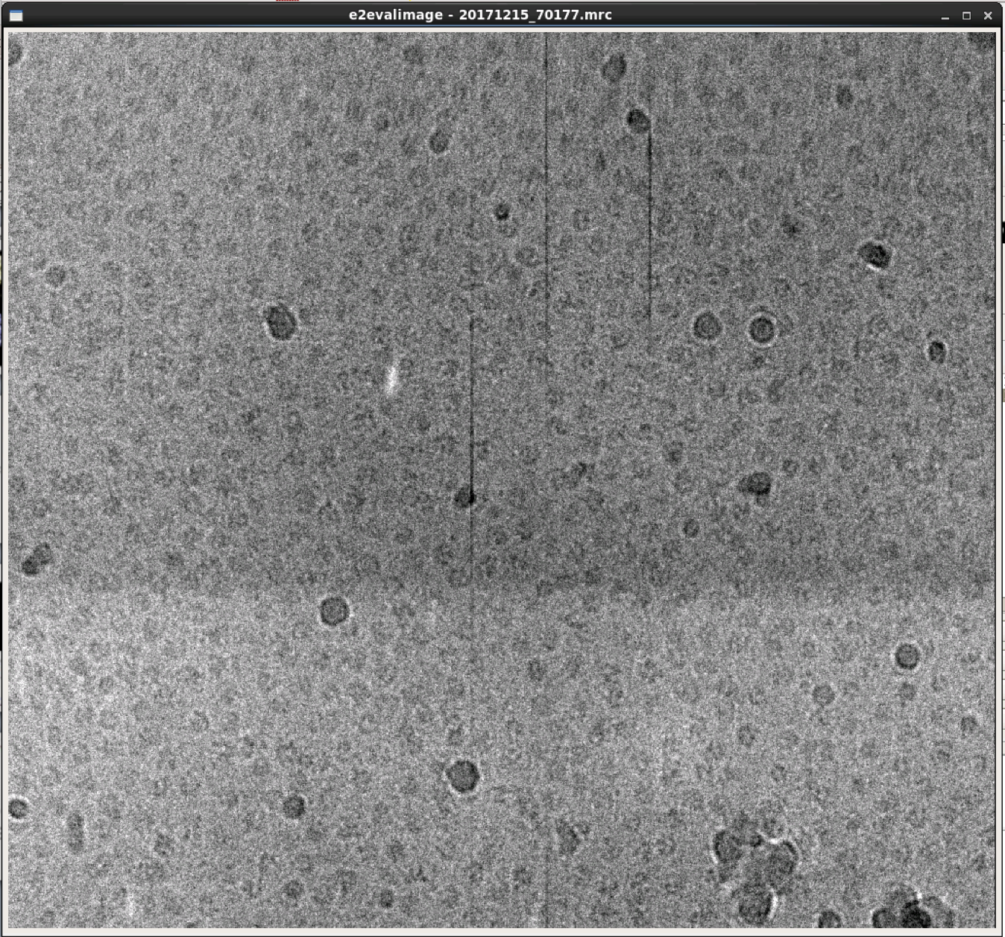
Motion Correction
Before Correction
After Correction

Slide 5
CTF Calibration

Slide 6
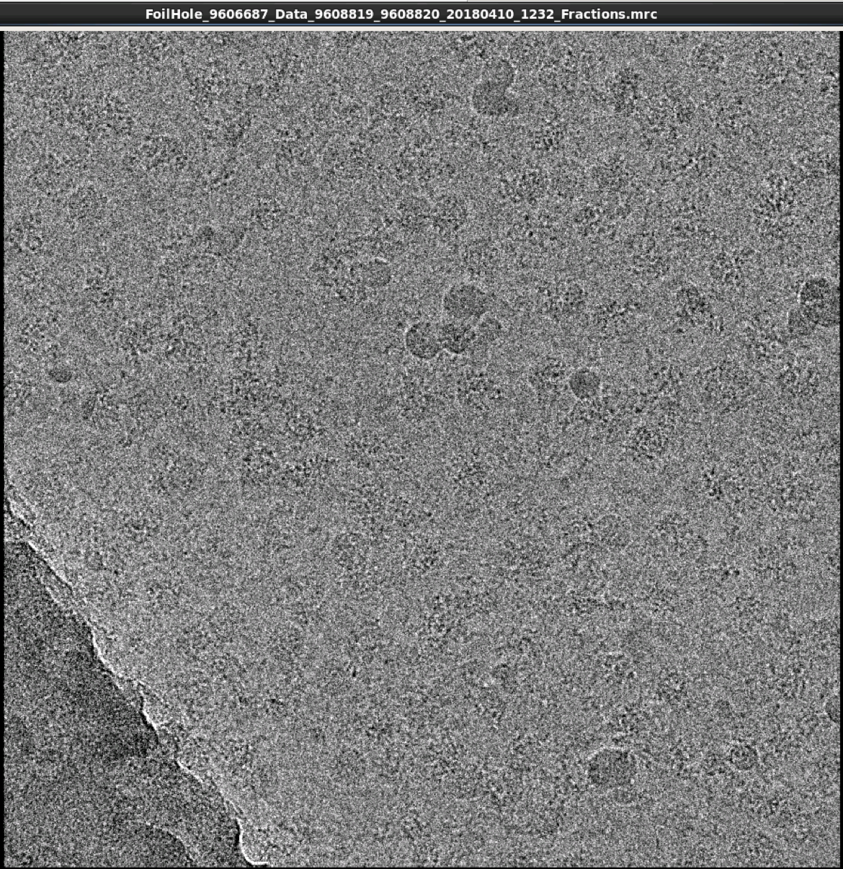
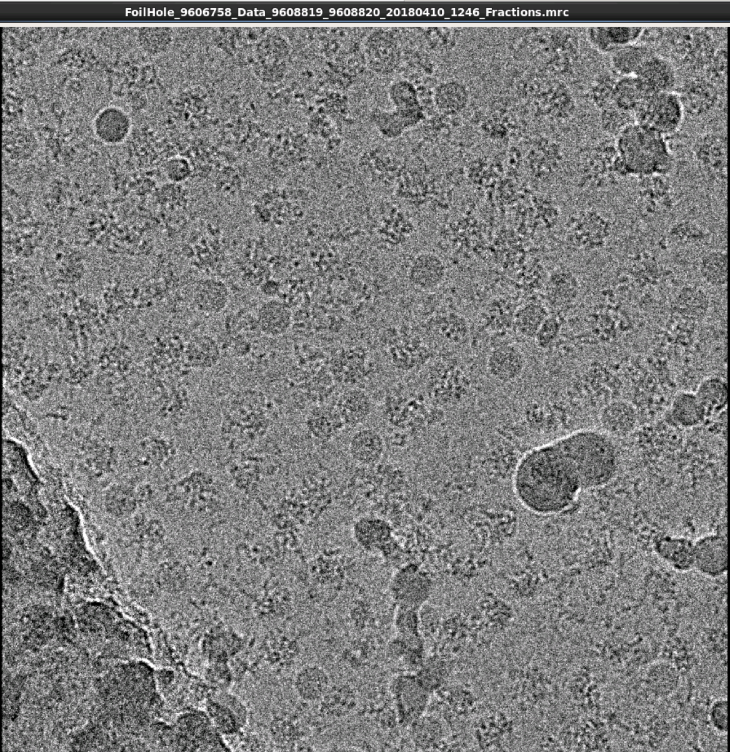
Imaging in Different Defocus
Defocus : 0.8um
Defocus : 1.75um

Slide 7
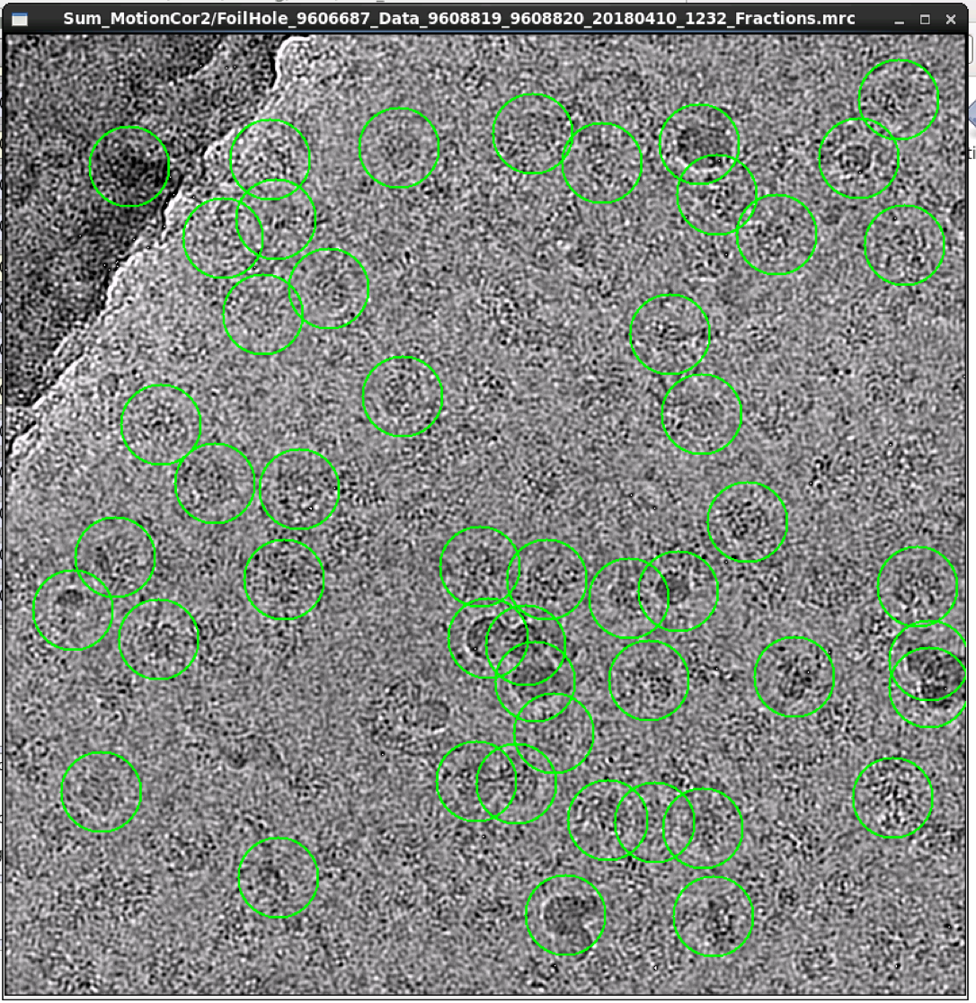
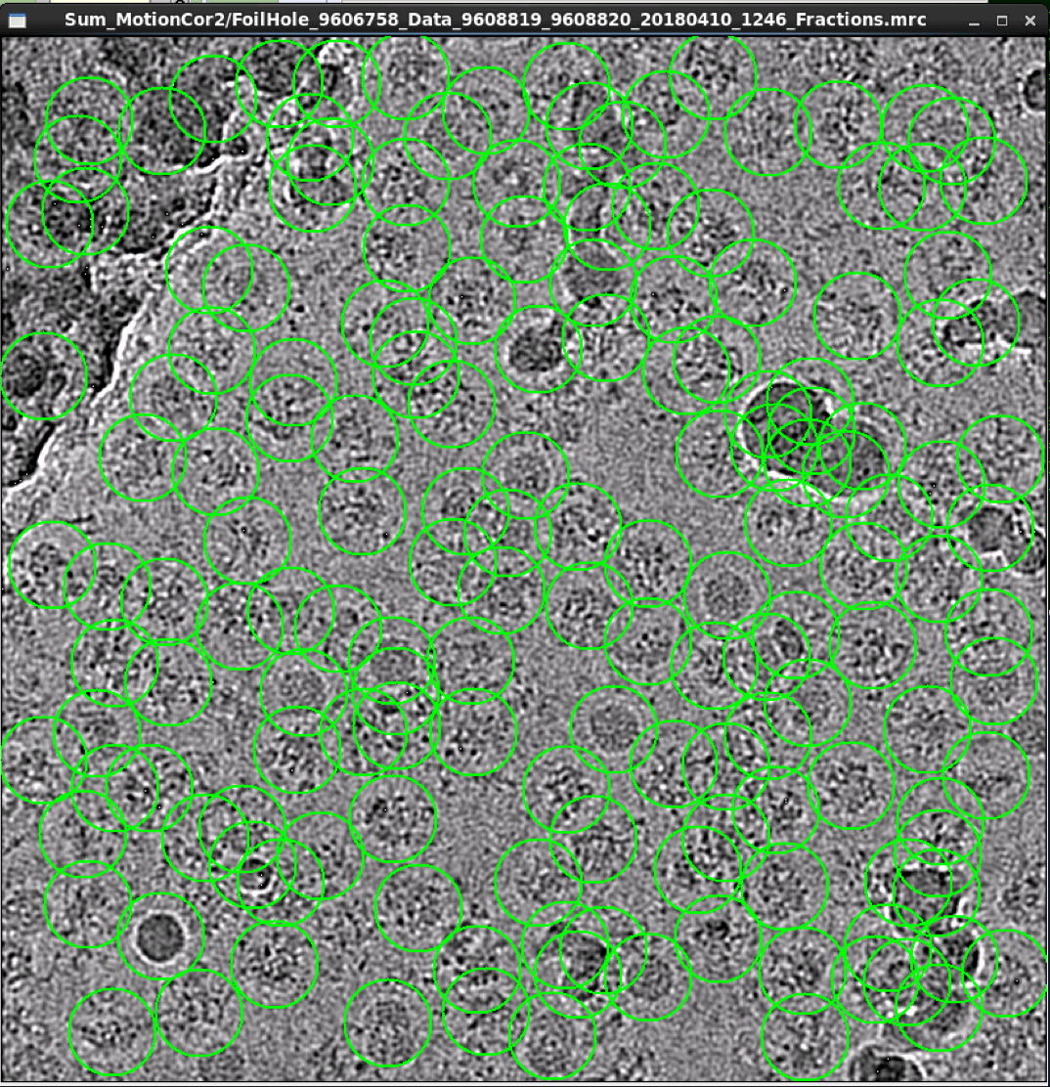

Slide 8
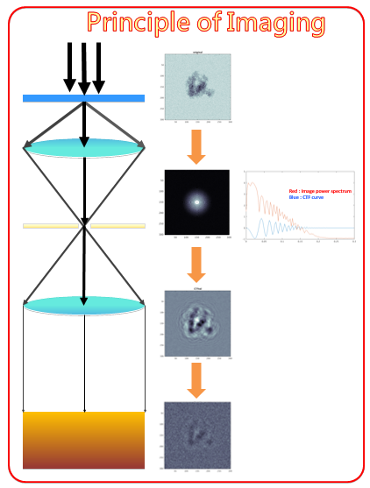
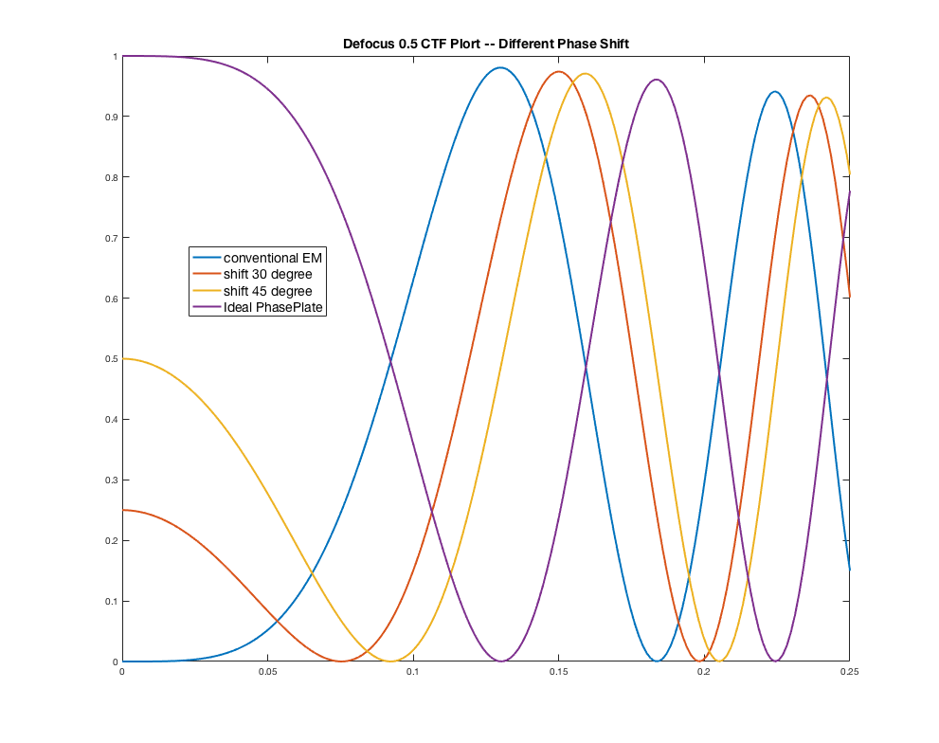
Defocus : 0.8um
Defocus : 1.75um
Camera

Slide 9
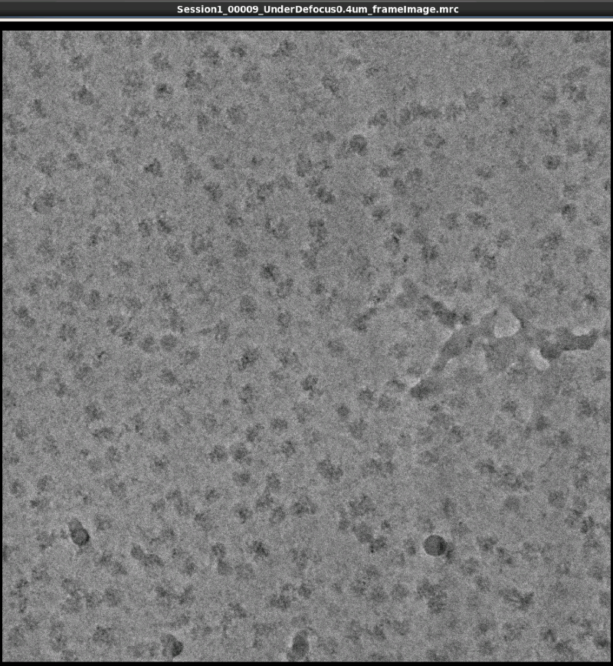
Conventional cryo-EM vs. Phase Plate
XSV CEM Talos-Artica --- Defocus : 0.8um
Defocus : 1.75um
TFII-F Volta PhasePlate --- Defocus : 0.7um

Slide 10
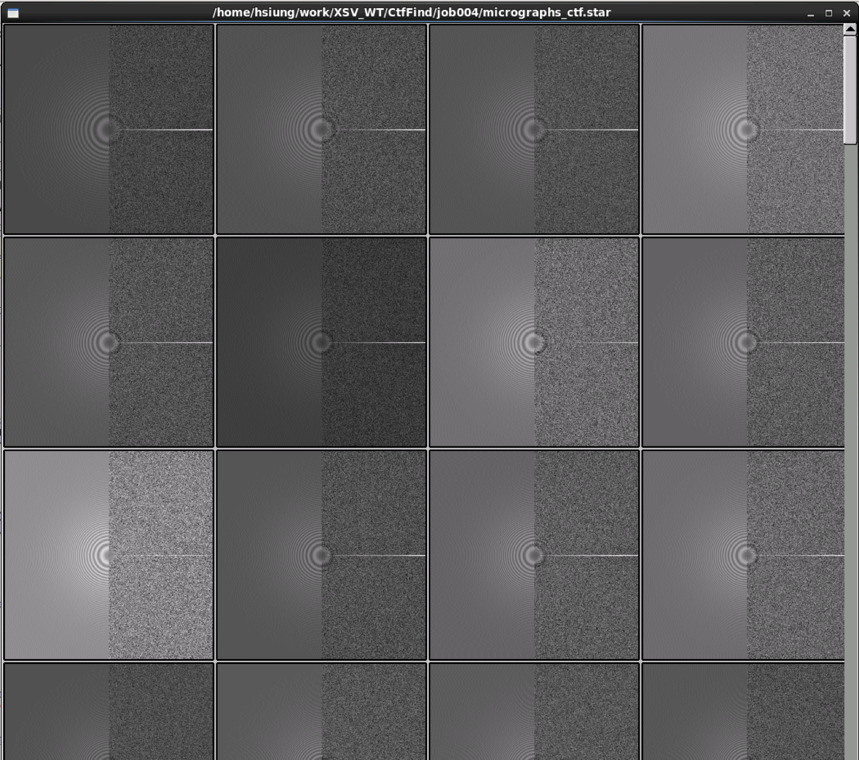
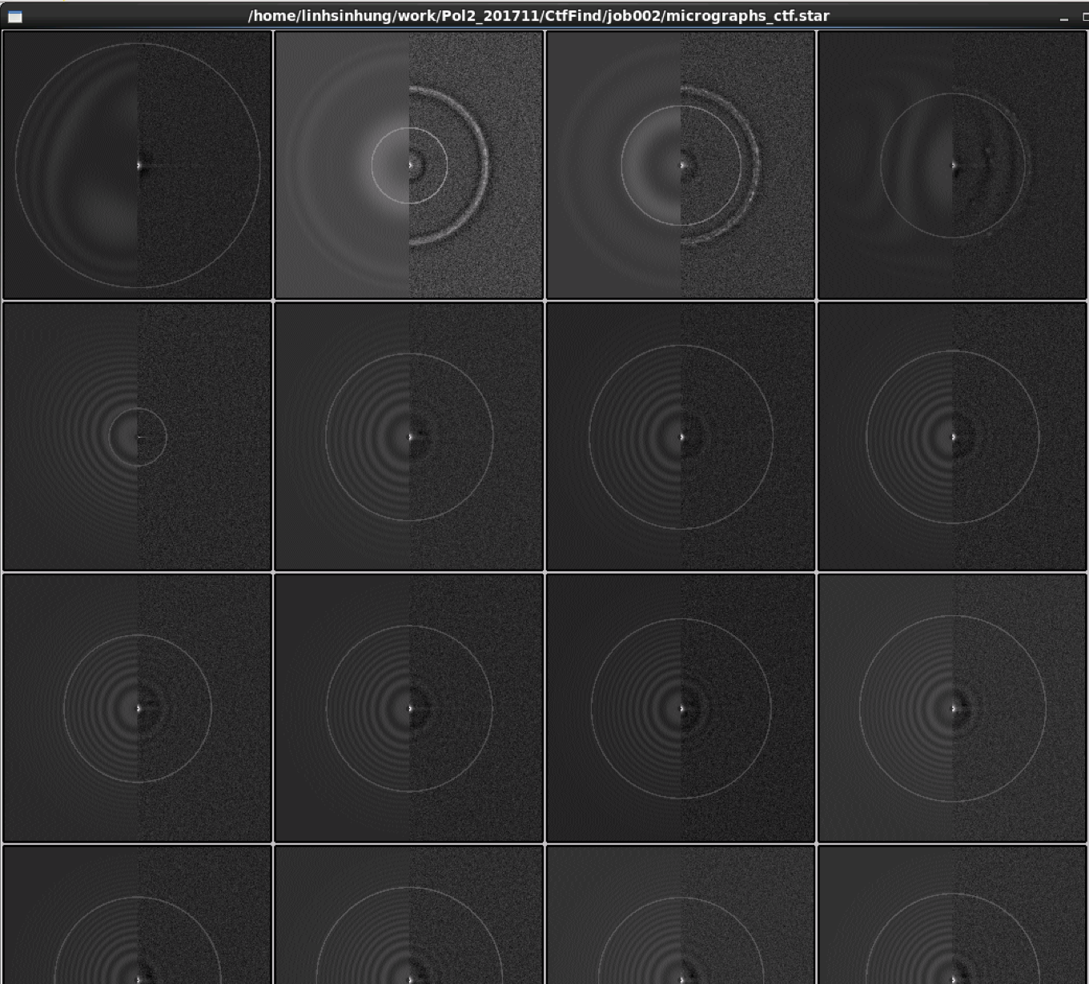
Conventional cryo-EM vs. Phase Plate
XSV CEM Talos-Artica
TFII-F Volta PhasePlate

Slide 11
Particle Picking

Slide 12
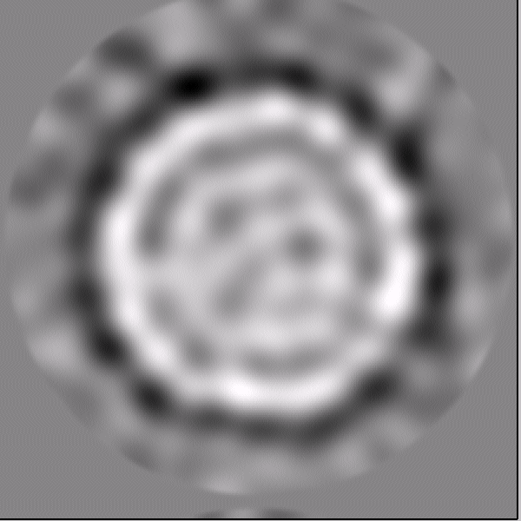
Auto-picking Program
Relion_autopick (GPU, Reference, any size micrograph)
Gautomatch (GPU, Reference Free, square size micrograph)
DoG-picker (Difference of Gaussians image transform)
Reference

Slide 13
Several Rounds 2D classification

Slide 14
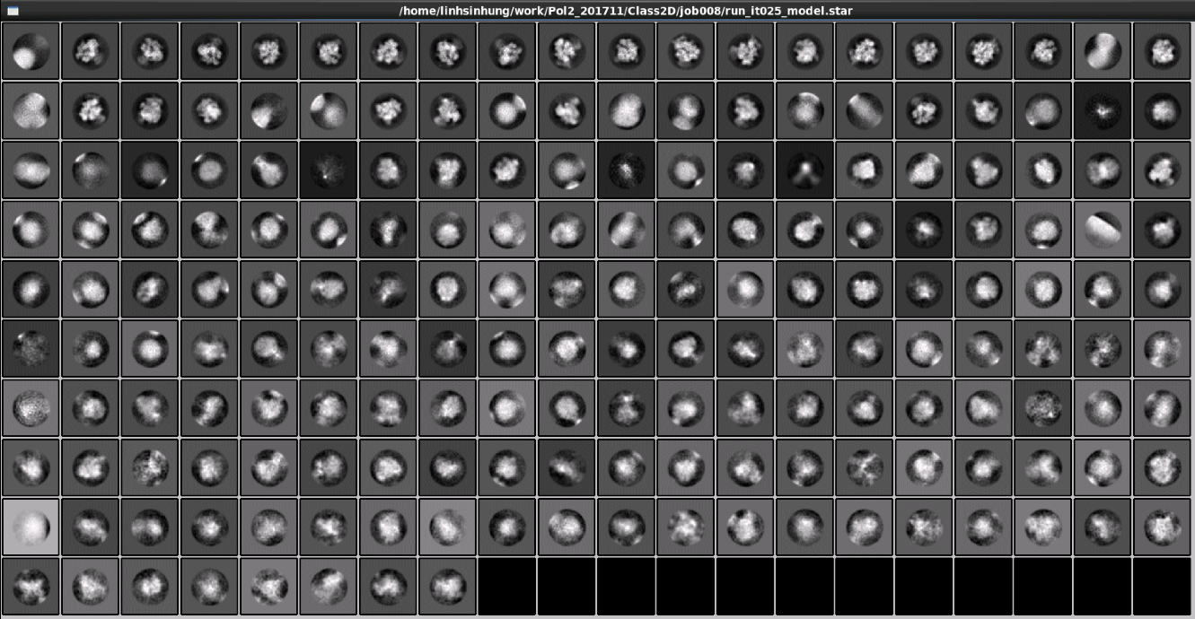
2D Classification – First Round after Autopicking
Particles Num : 83766
(Data Bin 3 to accelerate processing)

Slide 15
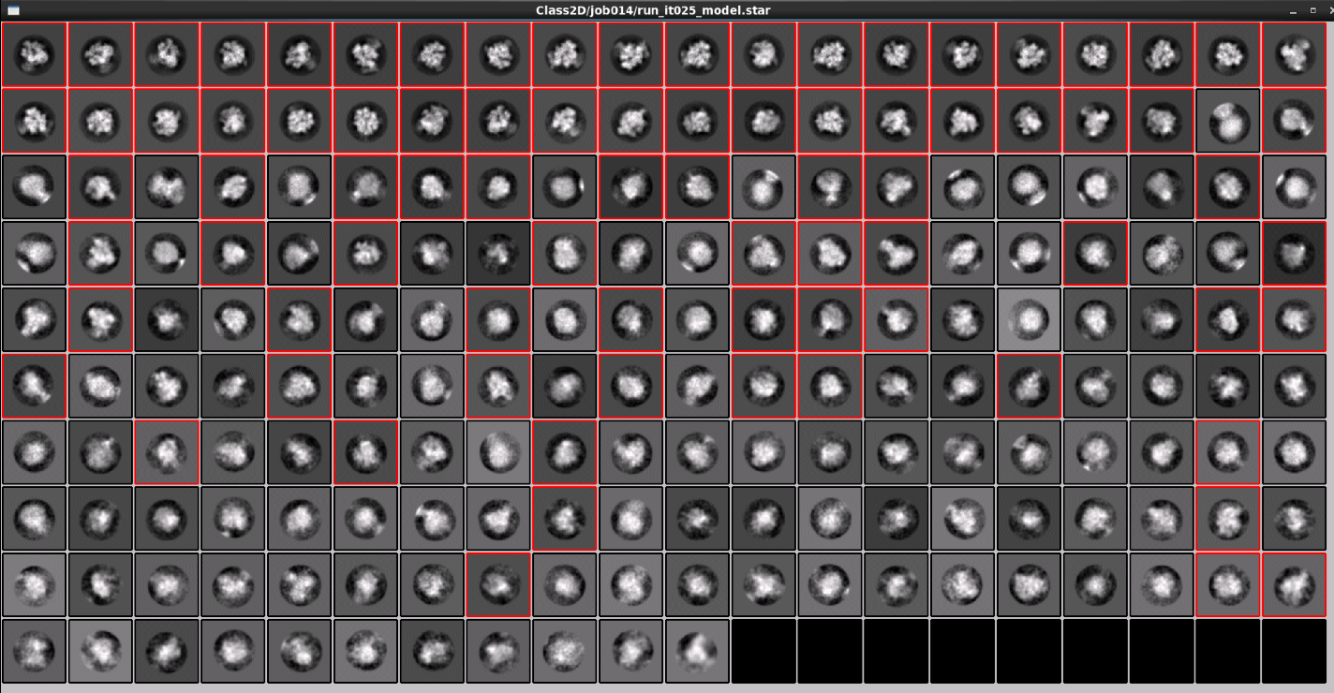
2D Classification – Round 2
Particles Num : 53069
(Data Bin 3 to accelerate processing)

Slide 16
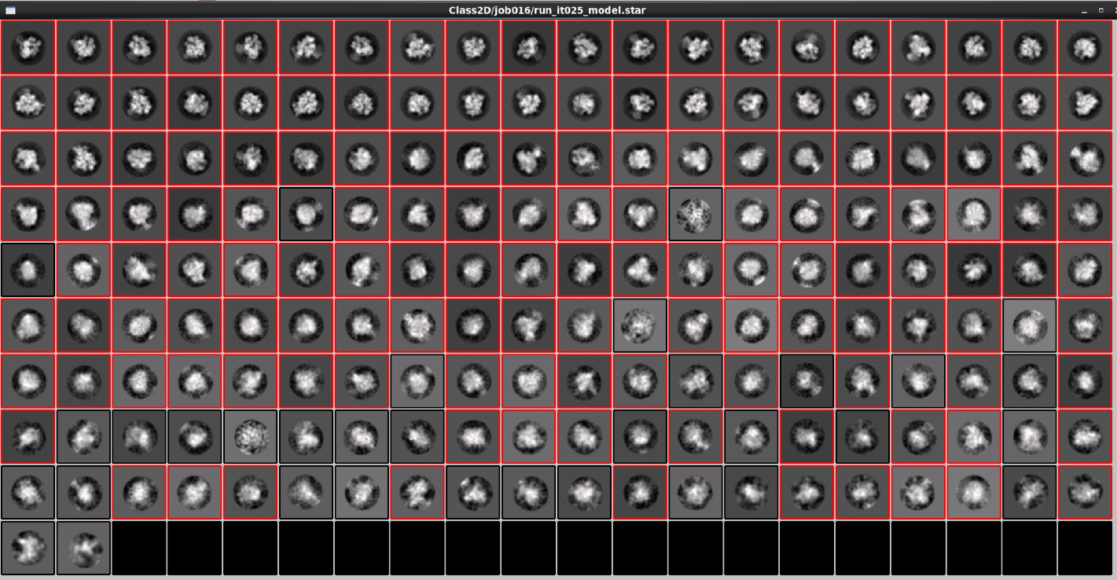
2D Classification – Round 3
Particles Num : 41896
(Data Bin 3 to accelerate processing)

Slide 17
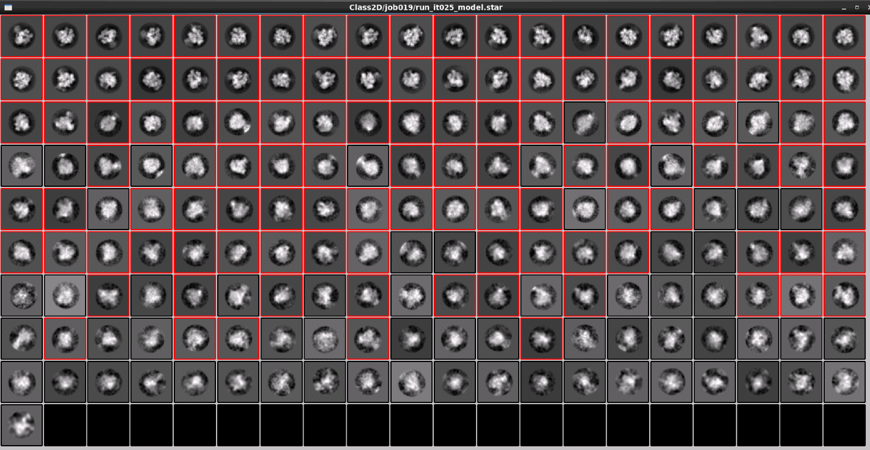
2D Classification – Round 4
Particles Num : 40758
(Data Bin 2 to accelerate processing)

Slide 18
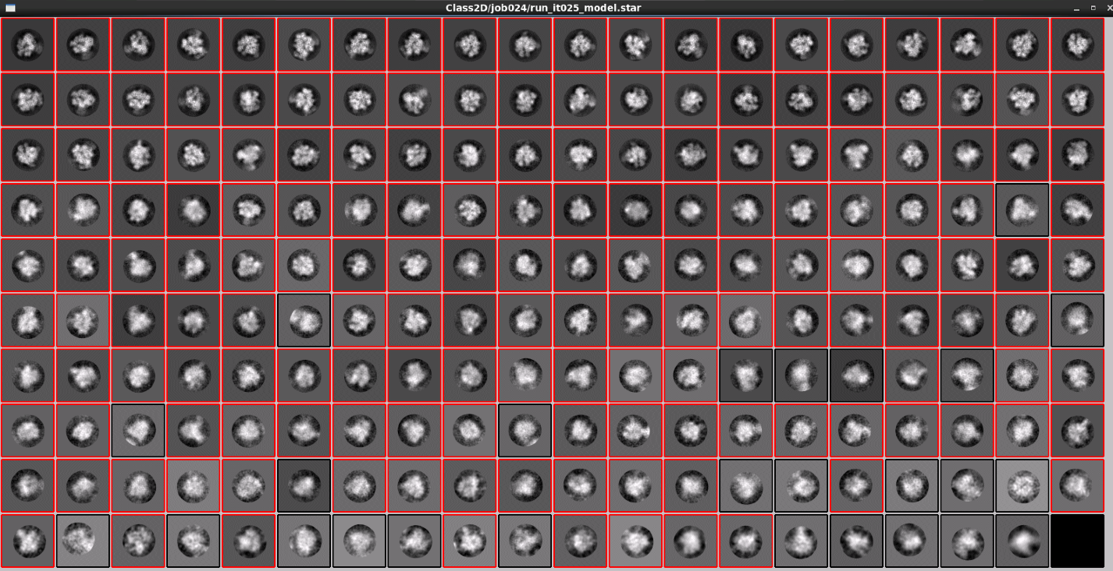
2D Classification – Round 5
Particles Num : 37917
(Original scale to accelerate processing)

Slide 19
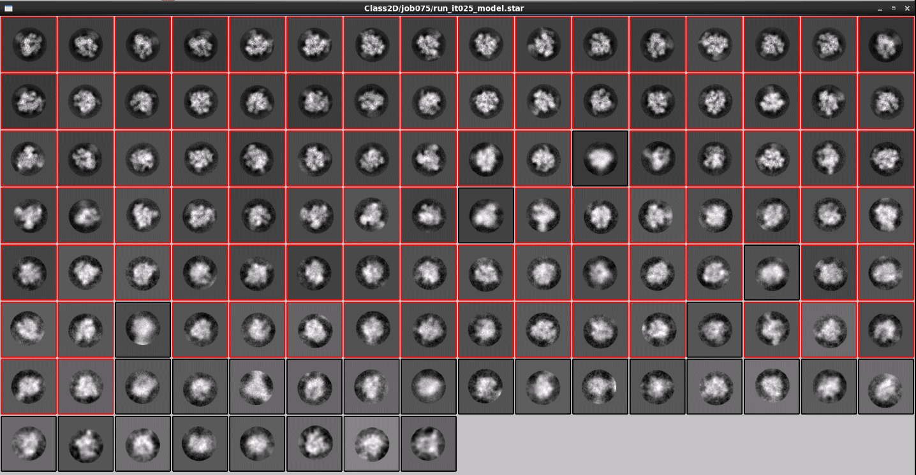
2D Classification – Round 6
Particles Num : 31912
(Original scale to accelerate processing)

Slide 20
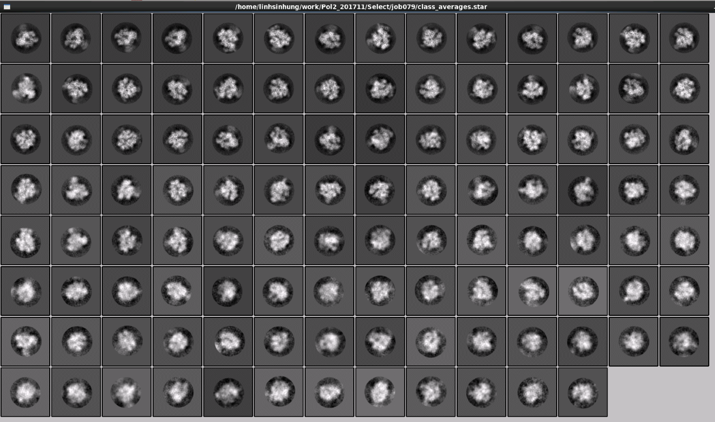
2D Classification – Final Selection of classes
30096 particles in 110 classes for initial 3D by Prime
Relion tag: job79

Slide 21
Ab-initial 3D model

Slide 22
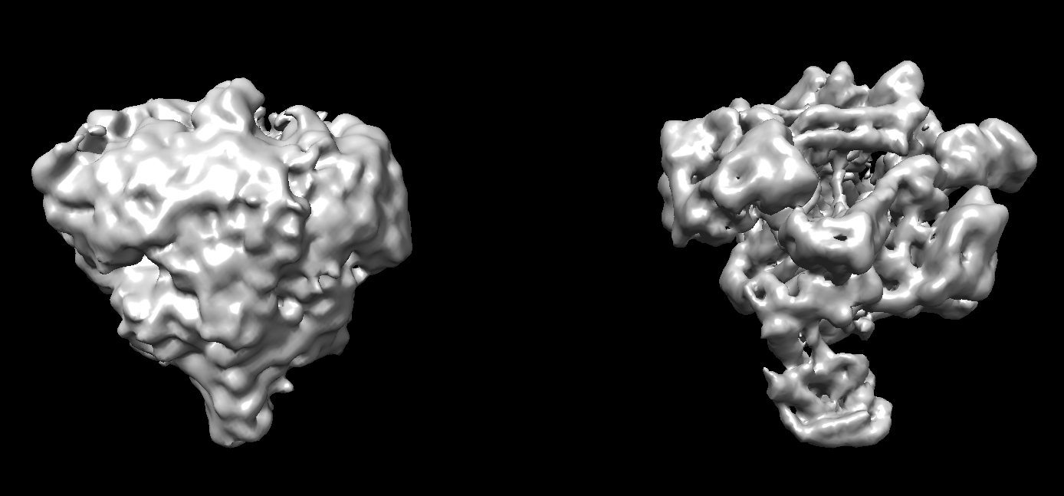
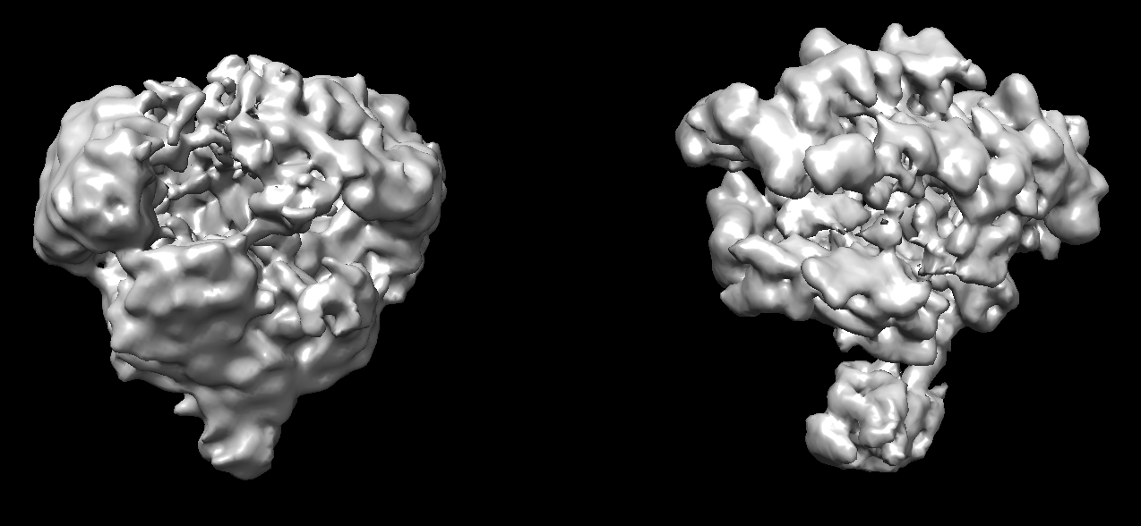
3D Ab-Initial Model – Prime + Relion Reference Free Reconstruction
Prime Ref-free Initial 3D
3D Refine by Relion
180˚
180˚
Relion tag: job81

Slide 23
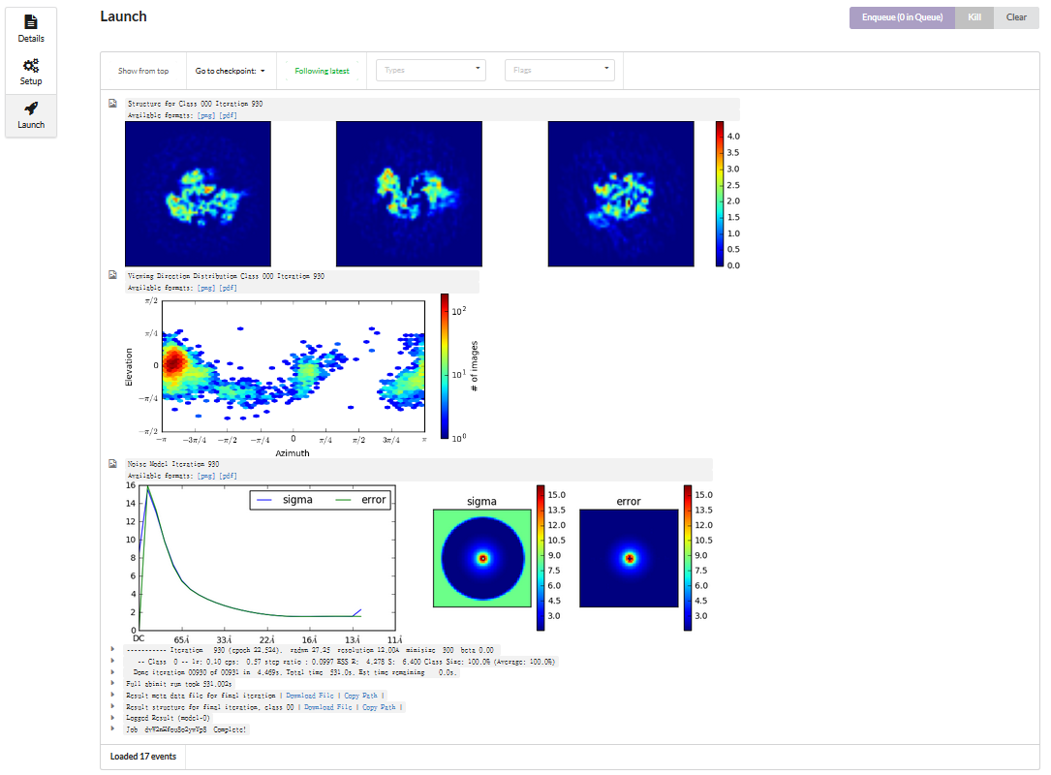
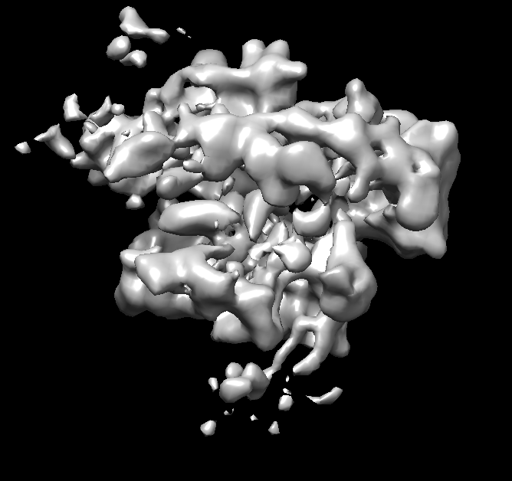
3D Ab-Initial Model – cryoSPARC
9000~ particles in TFII-F VPP data

Slide 24
3D Classification

Slide 25
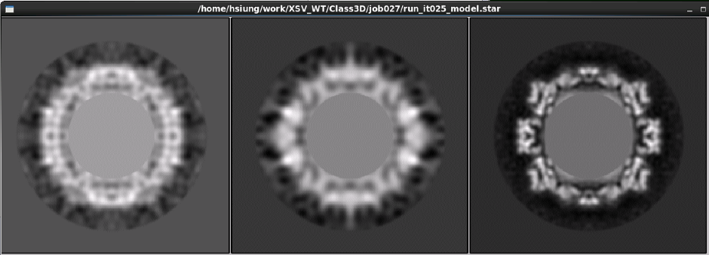
3D Classification – Highly Convergence
7.2%
6.1%
86.7%

Slide 26
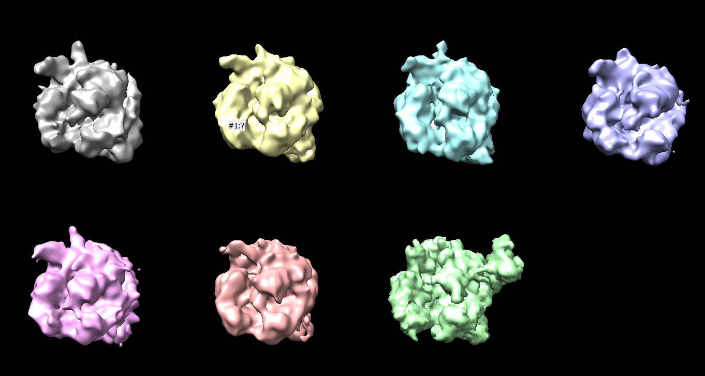
3D Classification – Non Convergence
Average Partition : ~16%
Class01
Class02
Class03
Class04
Class05
Class06
PDB Model:1wcm

Slide 27
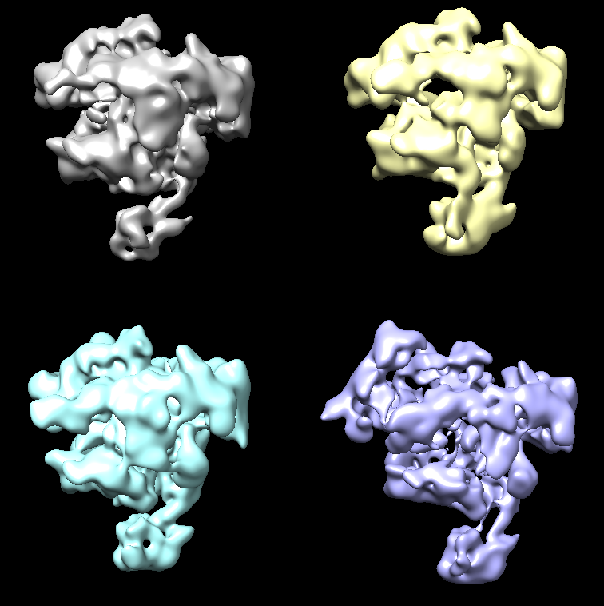
3D Classification – Heterogeneous Structure
Class1
EstimatedR:10.90Å
Class2
EstimatedR:12.57Å
Class3
EstimatedR:11.67Å
Class4
EstimatedR:11.67Å
Relion tag: job82

Slide 28
Post-processing & FSC

Slide 29
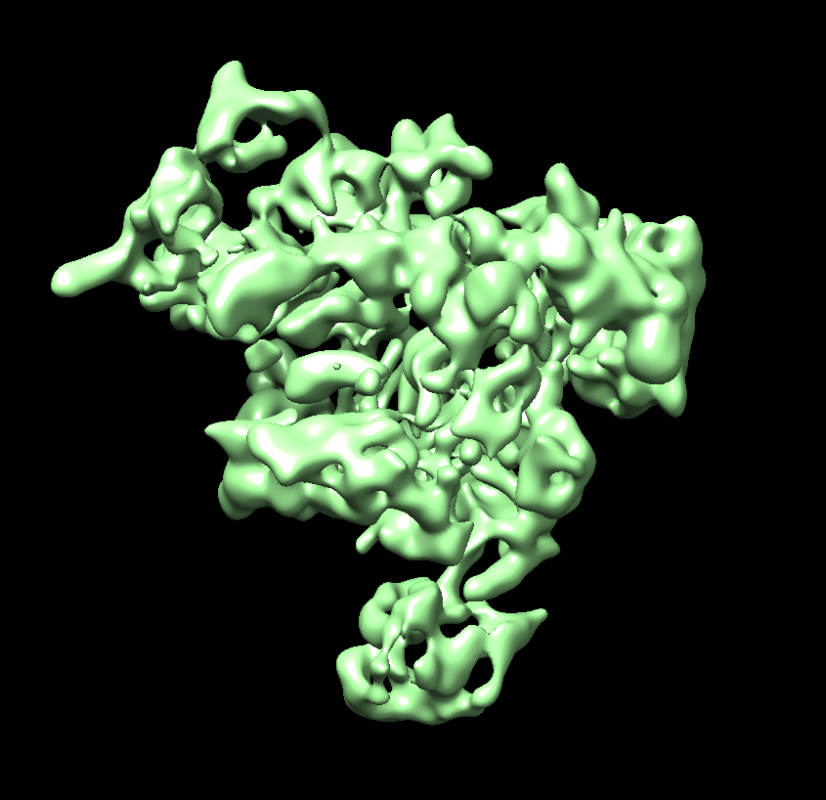
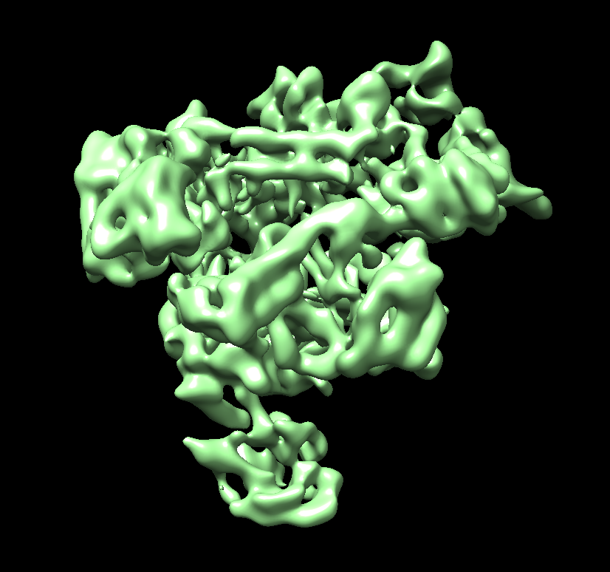
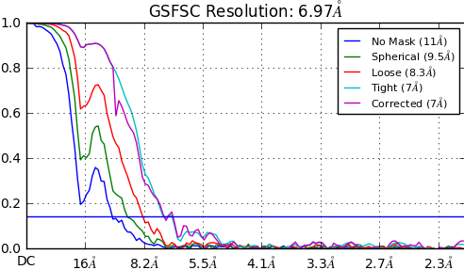
cryoSPARC Sharpen
180˚

Slide 30
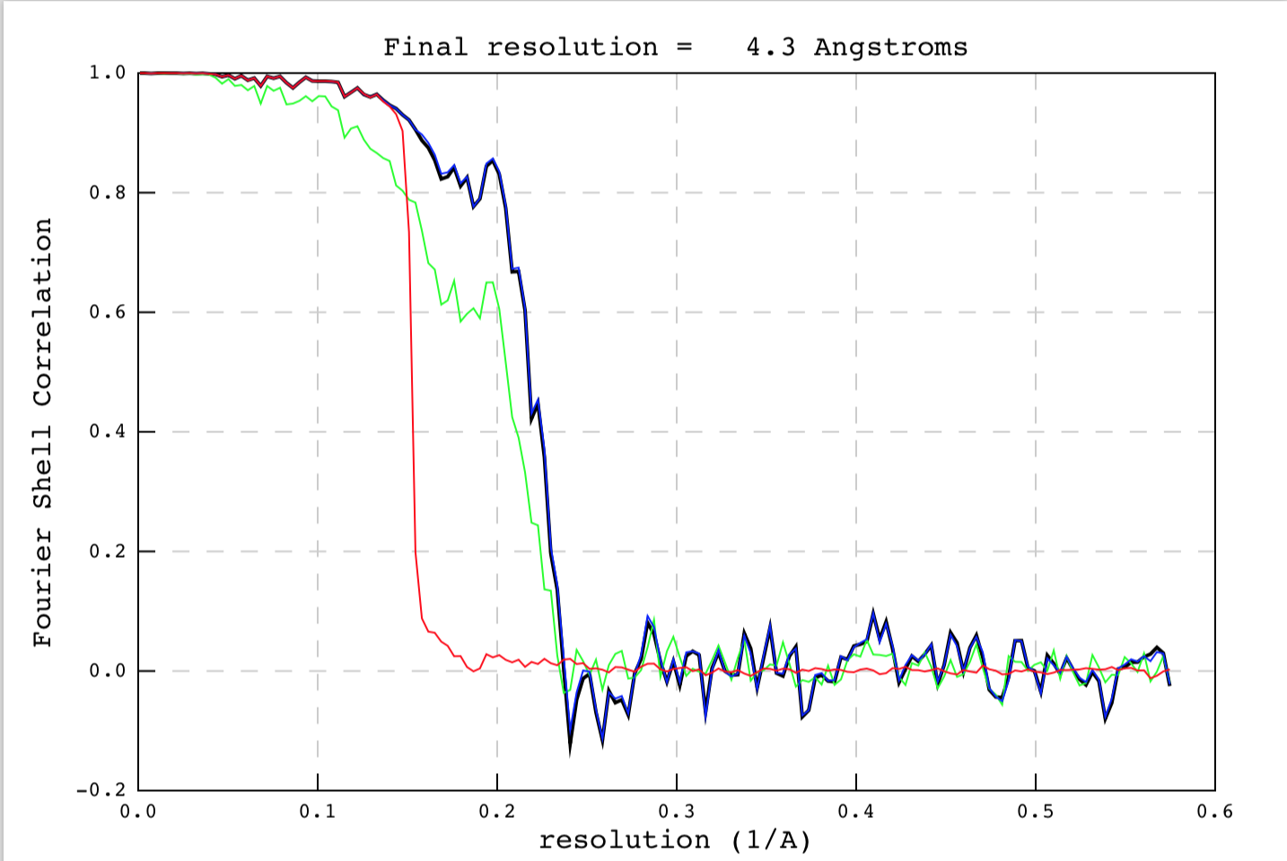
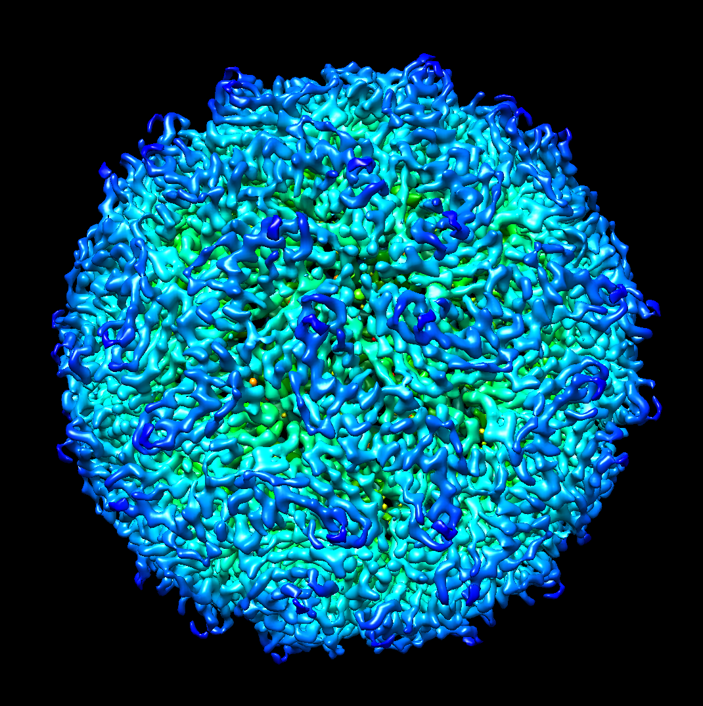
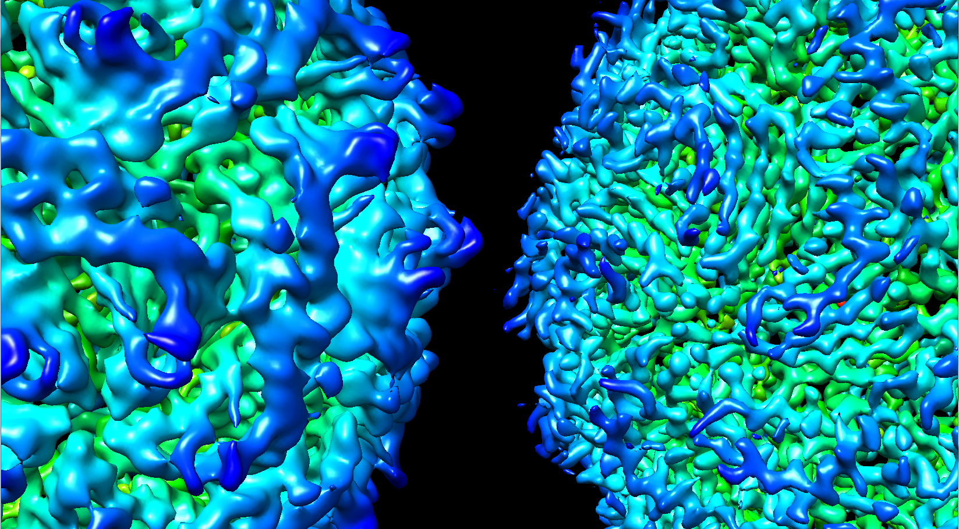
XSV Virus Quick Result
--CorrectedFourierShellCorrelationPhaseRandomizedMa
--FourierShellCorrelationMaskedMaps
--FourierShellCorrelationUnmaskedMaps

